Slide 1
Introduction to Concurrent and Parallel Programming
Single vs. Multi-tasking Systems
Applications of Concurrency
Parallel Programming
Methods of Implementing Multi-tasking
©Paul Davies. Not to be copied, used, or revised without explicit written permission from the copyright owner.

Slide 2
Single and Multi-tasking Real Time systems
In the last lecture we introduced Real Time systems and talked about two different classifications of such systems
  Hard vs Soft
  Event vs Time driven
Irrespective of those two classifications, a further classification of real time systems exists as shown below.
  Single tasking systems
  Multi-tasking (or concurrent) systems

Slide 3
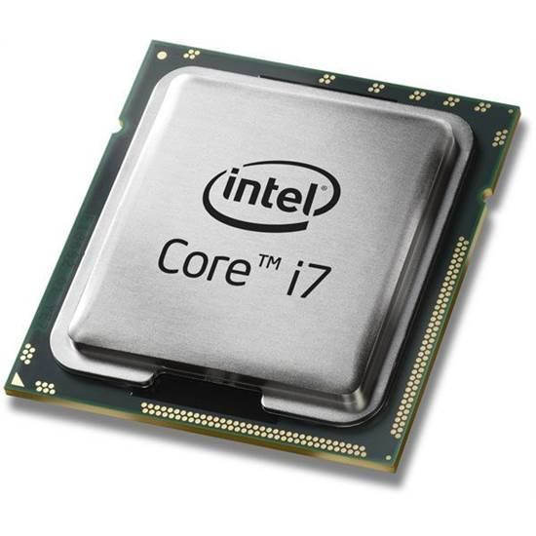
Question: What do we mean by a Single Tasking Real-Time System?
Answer: A system that runs a single sequential thread of code. That is, the same kind of programs you have written up to now e.g. in APSC 160, CPSC 259 etc.
Sequential ‘C’ Code
Assembly Code
Machine Code
push %rbp
mov %rsp,%rbp
sub $0x10,%rsp
movl $0x0,-0x4(%rbp)
cmpl $0x9,-0x4(%rbp)
jg 40084d <main+0x37>
mov -0x4(%rbp),%eax
mov %eax,%esi
mov $0x601060,%edi
callq
mov $0x400700,%esi
mov %rax,%rdi
callq 4006f0
addl $0x1,-0x4(%rbp)
jmp 400825 <main+0xf>
mov $0x0,%eax
leaveq
retq
55
48 89 e5
48 83 ec 10
c7 45 fc 00 00 00 00
83 7d fc 09
7f 22
8b 45 fc
89 c6
bf 60 10 60 00
e8 66 fe ff ff
be 00 07 40 00
48 89 c7
e8 a9 fe ff ff
83 45 fc 01
eb d8
b8 00 00 00 00
c9
c3
#include <stdio.h>
int main(void)
{
for (int i=0; i < 10; ++i) {
printf(“%d\n”, i);
}
return 0;
}
55
48
89
e5
48
83
ec
10
c7
Single Thread: Instructions executed one after the other on a single CPU core

Slide 4
What is a Multi-Tasking or Concurrent System?
A Multi-tasking, or concurrent system, involves running several pieces of the system code at the same time. There are several ways to achieve this :-
  Split the system into multiple separate programs, all running at the same time as processes.
  Split the system or program(s) into multiple sections of code all running at the same time as threads.
The above can be achieved physically by utilising
  A Single CPU System (with 1 or more cores)
  A System of Multiple CPUs (each with 1 or more cores)
  A Distributed System (i.e. a network of CPUs)
  (see http://en.wikipedia.org/wiki/Concurrency_(computer_science) )

Slide 5
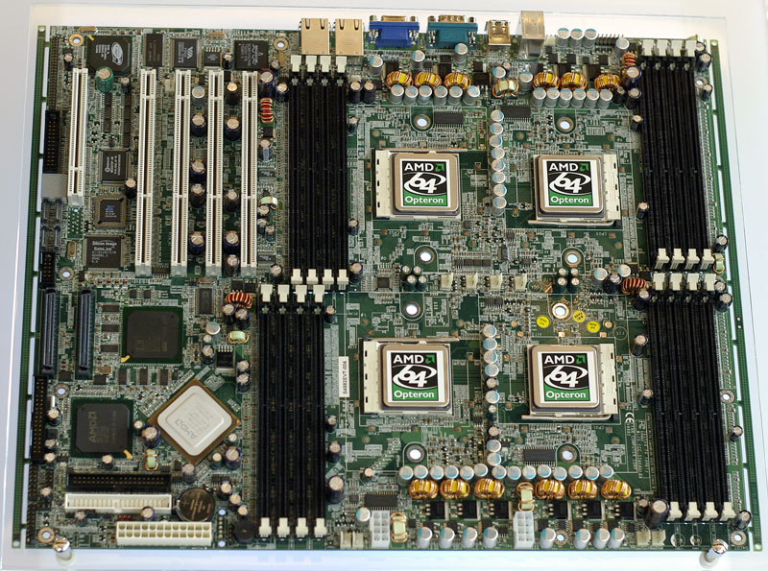
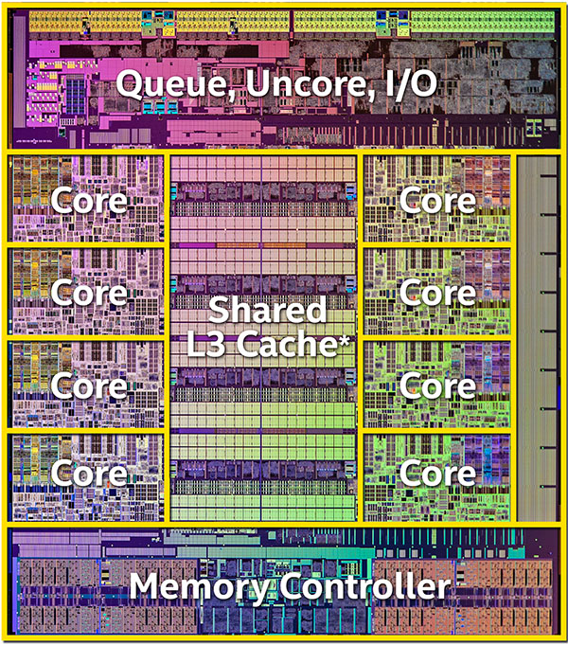
What do we mean by CPUs and Cores?
Processor Board with 4 Physical AMD CPUs that you could hold in your hand, each of which may contain multiple cores
(2018) An 8 Core I7 CPU with Shared Cache and Memory Controller. Each core can execute code, i.e. a thread

Slide 6
Example Multi Tasking Using Threads : Here sections of a program are executed in parallel (as threads) running on one Multi-Core CPU. This usually requires an operating system to create, control and allocate threads to each core.
#include "rt.h”
UINT _ _stdcall ChildThread1( void *args )
{
for (int i = 0; i < 1000; i ++)
printf( "Hello From Thread 1\n“) ;
return 0 ;
}
UINT _ _stdcall ChildThread2( void *args )
{
for (int i = 0; i < 1000; i ++)
printf( "Hello From Thread 2\n” ) ;
return 0 ;
}
void main(void)
{
// Create Threads using CThread objects
CThread t1( ChildThread1, ACTIVE, NULL) ;
CThread t2( ChildThread2, ACTIVE, NULL) ;
// wait for Threads to terminate
t1.WaitForThread() ;
t2.WaitForThread() ;
}
thread
thread
thread
How many threads in this program? Ans: 3
What cores/CPUs do they run on?
That’s left to the OS – We don’t have much control and may not be the same each time prog is run
Program written around multiple threads, we’ll come back to this in a later lecture

Slide 7
Multi-Tasking: Pros and Cons
Advantages:
Utilises CPU power - has the potential to utilise all available cores. Software performance grows with number of Cores and CPUs in systems.
Flexibility – system can be distributed across several servers (networked), perhaps in different countries.
Scalability – a single executable program can be run multiple times as separate tasks/processes (e.g. opening 10 copies of Microsoft Word to edit 10 documents in parallel).
Challenges:
Decomposing/Architecting system into appropriate concurrent tasks.
Communication (sharing data) between parallel tasks.
Synchronizing parallel tasks (ensuring things happen in a specific order).
Debugging and testing (especially difficult – how do you control the single-stepping of multiple threads all running at the same time?)

Slide 8
Example: Multi Tasking in a Distributed System
Multi-tasking is used extensively in web-servers where the same program code to handle a connection from a single remote client is loaded once into memory and a single copy of the code is run multiple times (as multiple threads on several cores/cpus) within the server, one per attached client, leading to highly scalable solutions.
Aside: Denial of service attacks attempt to crash a server by making hundreds of thousands of client connections per second in an attempt to overwhelm the CPU & Memory resources of the server. (see http://en.wikipedia.org/wiki/Denial-of-service_attack ).
Client Machines anywhere in the world
Server(s) anywhere in the world
Server
Thread
Client 1
3 threads instantiated from the same code to handle 3 attached clients. They share the same copy of the program code loaded into memory, but have their own separate storage for variables/stack etc to keep them independent.
Client 2
Server
Thread
Internet
Client 3
Server
Thread

Slide 9
Another Example where Multi-tasking leads to improved Scalability
An elevator system comprising of 4 elevators.
Here, instead of writing one big monolithic program that controls all 4 elevators (which would have lots of if-else statements), we just write a single task/thread to control 1 elevator (simpler) and run 4 copies of the code (as 4 threads) with an elevator scheduler to delegate floor requests to each.
Designing our software architecture around parallel tasks/threads thus leads to more scalable and flexible solutions.
Problem: How hard would it be to scale both solutions to 8 elevators?
main()
{
}
Elevator
Scheduler
Elevator requests
commands
Elevator requests
vs.
main()
{
}
main(){
}
main()
{
}
main()
{
}
Elevator 1
Elevator 2
Elevator 3
Elevator 4
Solution 1: Big Monolithic Single Tasking System
Solution 2: Multi-Tasking System

Slide 10
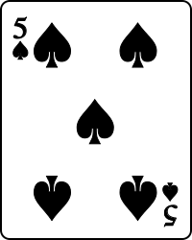
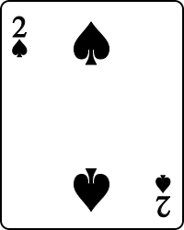
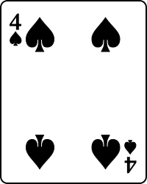
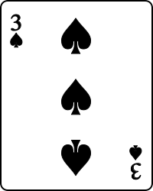

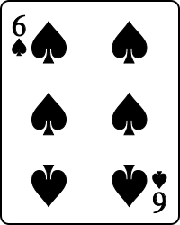
Parallel Programming
Parallel programming is a specialised branch of concurrent programming which focuses on the design of algorithms intended to make software run faster in a multiple CPU/multiple Core environment.
(Note: Concurrent systems programming is not generally about faster algorithms or solutions, it's more often about designing scalable solutions, with the option of having several things happen at the same time).
Example: A parallel programming version of the Quick-Sort algorithm (involving multiple threads) leverages the power of multiple cores in an attempt to make the sorting faster.

Slide 11
Parallel Programming (cont…)
As another example, consider a program designed to repeatedly evaluate the following mathematical expression with new A, B, C data each time.
X = B² – 4AC
We could easily write a single tasking solution for this problem using 1 line of C/C++ code inside a loop.
However, the resulting 1 line solution will run no faster on a 8 core CPU than it would on a single core CPU.
This is because neither the compiler, CPU or the operating system have the ability to automatically identify and partition the problem into several smaller tasks (threads) that can be executed in parallel on multiple cores.

Slide 12
However, a smart programmer could easily architect the previous expression into 3 smaller tasks (implemented as threads running on multiple cores):
  One thread could calculate B²
  A second thread could calculate 4AC
Note: Because neither of the above 2 expressions depend upon the outcome of the other, these two threads could be executed in parallel (i.e. at the same time).
In fact an operating system could even allocate these new tasks to run on separate cores, at the same time.
  Finally a 3rd thread could perform the ‘-’ (subtraction)
  i.e. take the output of the previous two threads and subtract them.

Slide 13
Problems: Data Dependencies, Communication and Synchronisation
Designing this 3rd thread however highlights some of the difficulties of parallel programming.
That 3rd thread is required to communicate with and synchronise itself to the output generated by the previous two threads.
Generally speaking, splitting a system into smaller parallel tasks increases data dependencies, where data required by one thread is dependent upon data produced by another, such as the subtraction earlier.
The impact of this is that one thread must be designed to wait for another to complete. This in turn limits the amount of parallelism that actually takes place in the solution which in turn limits the speed at which it can be calculated. Of course pipelining the calculations and data (i.e. 1st and 2nd threads work on the next set of data while the 3rd thread deals with the results of the previous calculation) might help, but that introduces problems of it’s own.
(Note research into the field of parallel programming languages is attempting to create compilers that can automatically parallelise sections of code for execution on multiple cores, which should give a worthwhile boost to the performance of existing ‘legacy’ programs.)

Slide 14
Approaches to Parallel Programming
Any fool can take an existing sequential algorithm/program, compile it and run it on a multi-core computer. The trouble is, it won’t run any faster, and all those extra cores will sit there idle.
Designing an algorithm specifically to take advantage of multiple cores for fast processing is very challenging and requires a dedicated (i.e. a parallel programming) course in itself.
For example, you may have to throw away or at least substantially modify some of those “classic” algorithms that appear in text books and courses like CPSC 259 because they have evolved to be the fastest solution for sequential execution on a single core.

Slide 15
Parallel Programming Approaches
To optimise an algorithm for parallel operation, on multiple cores, may mean that the data will have to be reorganised/repartitioned) so that several cores can work on their own separate copies of the data independently of each other to reduce the number of data dependencies.
It’s very common and frustrating to find that after spending many hours attempting to create a parallel version of a sequential algorithm, it often performs worse than the sequential solution.

Slide 16
Problems that lend themselves well to parallel processing include
  MPEG/JPEG decoding,
  Image processing,
  Weather forecasting,
  Finite element analysis etc.
This is because it is possible to split the data processed by these types of problem into smaller independent chunks for processing in parallel on separate cores. The more cores you have, the more chunks can be processed in parallel (in theory).
Adobe Photoshop is an example of a well written multi-threaded program. It will show a significant performance increase when multiple cores exist.
If an algorithm contains too many data dependencies (implying thread communication and synchronization issues and overheads) then little benefit will be seen by a parallel multi-core solution.

Slide 17
Not all problems lend themselves to a parallel solution. For example, a program to calculate the Fibonacci series
(1, 1, 2, 3, 5, 8, 13, 21, ...)
is inherently a sequential problem and will never lend itself to a faster parallel solution.
This is because the formula for calculating the next element in the series is given by the equation
F_{(n + 2)} = F_{(n + 1)} + F_{(n)}
That is, each element in the series can only be calculated after the previous two, i.e. sequentially, due to data dependencies, thus is it not possible to calculate each element in the series in parallel. The best we can hope for most programs is that we can “accelerate” key sections of it through multi-threading.
For a good overview of parallel programming visit https://computing.llnl.gov/tutorials/parallel_comp

Slide 18
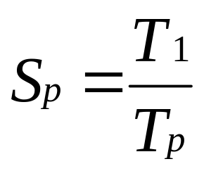
Speedup and Parallel Programming
Speedup is a simple measure of the performance increase of a parallel algorithm running on multiple cores vs. the equivalent sequential version running on a single core.
Speedup is defined by the following simple formula:
p is the number of available cores.
T₁ is the execution time of the sequential algorithm with 1 CPU/core.
T_{p} is the execution time of the parallel algorithm with ‘p’ CPU/core.
Sequential Quick Sort: 10 s
Parallel Quick Sort (p=4): 7 s
Speedup: 1.4x

Slide 19
Decoding time for an MPEG sequence
7
6
5
4
Speedup
3
2
1
0
4
2
4
# CPUs
2
1
1
# Cores per CPU
Questions to think about:
Why is speedup not linear, i.e. when you double the numbers of cores why does speedup not appear to double?
Why might doubling the number of CPUs not always yield the same speedup as doubling the number of cores?
Can speedup ever be < 1 ?

Slide 20
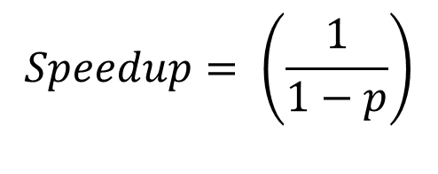
Amdahl’s Law and its impact on Speedup
Speedup is limited by the amount of code that you can not speed up
Amdahl's law is often used in parallel computing to predict the theoretical speedup when using multiple cores. For example, if a program needs 20 hours to complete using a single thread, but a one-hour portion of the program cannot be parallelized, but the remaining 19 hours (p = 0.95) of execution time can be parallelized, then regardless of how many threads are devoted to a parallelized execution of this program, the minimum execution time cannot be less than one hour. Hence, the theoretical speedup is limited to at most 20 times the single thread performance
(Source: https://en.wikipedia.org/wiki/Amdahl%27s_law)
P = proportion of code you can speed up e.g. 95%

Slide 21
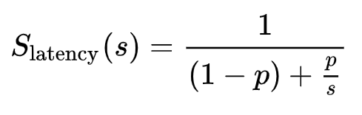
Amdahl’s Law can also be stated like this
S_{latency} = overall speedup of the parallelised task.
s = speedup of the part of the task that benefits from parallelism.
p = proportion of execution time that the new parallelized task originally took.
Thus if you can make 25% of your code run twice as fast (s = 2, p = 0.25), the best you can hope for is a 14% overall speedup.

Slide 22
Implementing Multi-tasking (Concurrency)
Multi-tasking systems can be realised in a variety of different ways
  Pseudo Multi-Tasking - (i.e. also known as ‘faking’ it)
  Multiple Cores/CPUs - (true multi-tasking)
  Distributed CPUs - (Multiple CPUs communicating over a Network)
  Time-Sliced Core/CPU - (compromise, used by most systems)

Slide 23
Approach 1 : Pseudo Multi-tasking Systems:
Here, a cheap form of ‘fake’ multitasking is implemented by the system through clever programming designed to make it appear as if the system is executing several repetitive tasks in parallel. There’s no attempt to make anything faster.
With a carefully crafted program decomposed into smaller tasks, each of which is brief and can be executed over and over again, inside a loop, we can design a system that gives the illusion of concurrency.
The program below demonstrates this concept using a loop built into a program.
Tasks are simulated via functions called repetitively within the loop.
void main(void)
{
while(1) {
Monitor_Temperature() ;
Control_flow_rate() ;
Update_Display() ;
}
}
Tasks are ‘simulated’ with function calls which are invoked rapidly and repeatedly to create the illusion they are all running at the same time.
Infinite loop creates illusion that all tasks run concurrently

Slide 24
Advantages of Pseudo-Multitasking Systems
Simple learning curve, just a bunch of function calls inside a forever loop.
No complex operating system required.
No new theories required. What we learned in APSC 160 will suffice.
Inter-Task Communication : Can be handled using global variables.
Task Synchronisation : Automatic, only one task is actually running at any point in time, therefore all tasks are automatically synchronised to the completion of the previous tasks each time around the loop.

Slide 25
Disadvantages to Pseudo Multi-tasking Systems
Each task has to be written so that it can be called repeatedly within the system and it has to be brief.
An individual task (i.e. function) must not be written so that it
  Sits in its own internal loop consuming large amounts of CPU time.
  Gets involved in some operation that would cause it to delay its return, such as waiting for input from a keyboard.
If either of the 2 points above are violated, then other tasks/functions in the main loop would be prevented from executing and the illusion of concurrency will be lost, so its use is limited.
There are also problems with task protection. Any “task” that crashes may wipe out all the other tasks.
There is also no easy way to assign priorities to tasks or change the order in which things happen in response to real world situations.

Slide 26
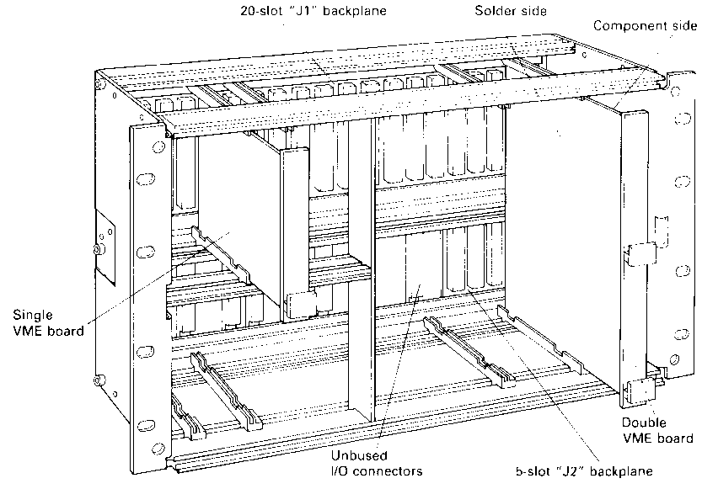
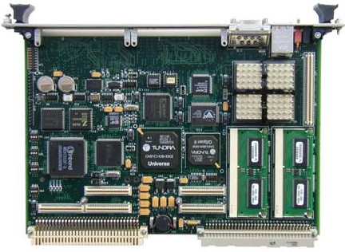
Approach 2 : Multiple CPUs on Shared Backplane
Multiple processor boards plugged into backplanes such as VME bus each with its own CPU which is dedicated to a single process/activity.
Very High performance and expensive.
Useful if the number of tasks is fixed and known at design time. May not easily accommodate dynamic process creation as a change in the number of processes may require a change in number of CPU cards. (It might be possible to address this with an operating system inside each processor board)
CPU's/tasks communicate via shared memory boards plugged into the backplane.
Not very flexible and vulnerable to Power supply failure

Slide 27
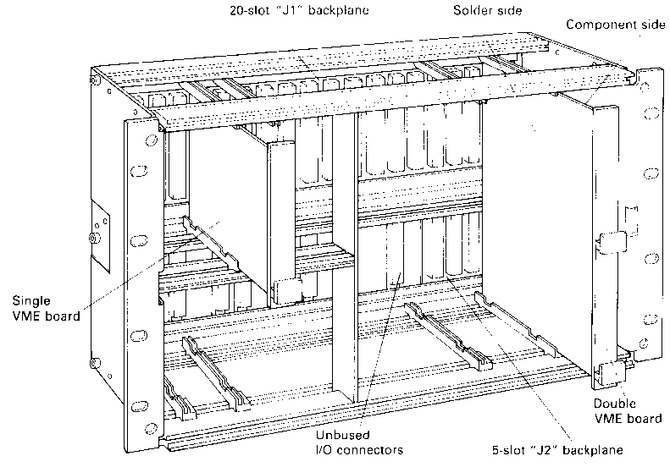
Approach 3 : Distributed Systems
Node A
Node B
Network
Node C
Node D

Slide 28
With a distributed system each task still has it's own dedicated networked CPU.
A Real time system might require the use of a deterministic network based on the concept of prioritised arbitration. Here a node can transmit only when the network is idle and it has a priority higher than all other nodes trying to transmit at the same time. Furthermore, it can only send one limited size packet of information after which it has to release the network for use by any other node.
Here the delay in transmitting an arbitrary sized message from one node to another can be calculated and is related to
  Speed of network e.g. Mbps.
  Size of a packet in bytes.
  Size of the message being transmitted in bytes.
  Number of nodes on network.

Slide 29
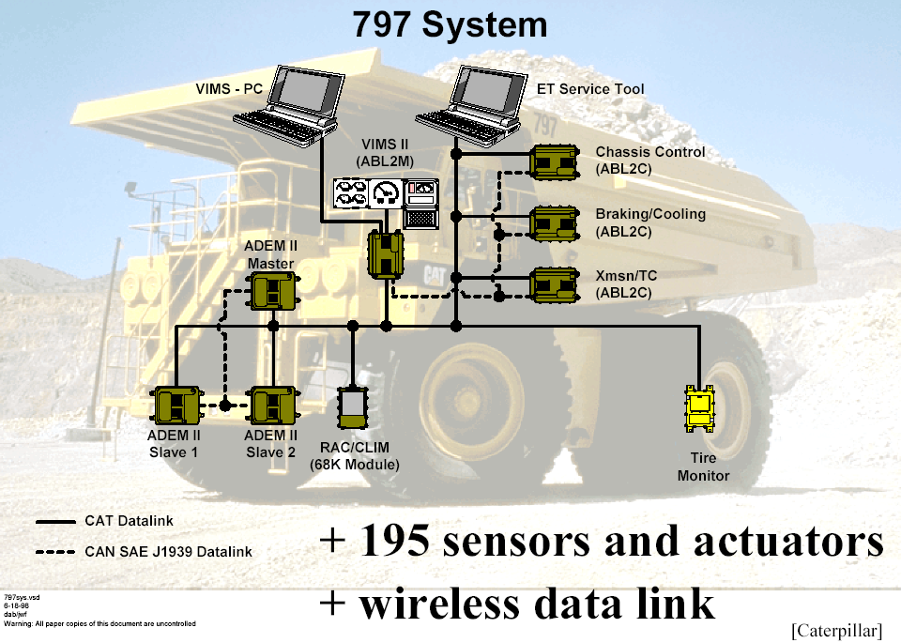
Example distributed (embedded) system

Slide 30
Classifications of Multiple CPU Architectures - Heterogeneous
A System composed of multiple dissimilar CPUs
  CPUs can be chosen on basis of suitability for the task e.g. DSP for signal processing, Graphics for Image processing, Intel/AMD etc. for general workhorse functions and FPGAs/ASICs for dedicated hardware acceleration.
  System Software is complex and must target multiple CPU and H/W architectures.
  Interconnect of CPUs also highly specific requiring dedicated solutions.
  Difficult to integrate to run under a single controlling operating system environment.
  Not very flexible, but performance can be exceptional, perhaps even optimal.
  (see http://en.wikipedia.org/wiki/GPGPU for development in graphics chip programming)
Control processors
Shared Memory
C
C
M
M
M
M
Specialised interconnect (backplane, networks etc)
M
M
M
M
DSPs, FPGAs, ASICs and Graphics Accelerators

Slide 31
Classifications of Multiple CPU Architectures - Homogeneous
A System composed of multiple identical CPUs/Cores – e.g.
  Dual/Quad Core Processors from Intel/AMD
  Sometimes referred to as Symmetric multi-processing
Advantages/Drawbacks
  Any CPU/core can run any task. For example, one CPU/core could start a task, but have it completed by another.
  CPUs easier to integrate under the control of one Single Host Operating System, e.g. Windows that controls multiple CPUs and Cores inside your Laptop/desktop computer.
  OS can carry out load balancing, distributing work among available CPU/cores
  Easy to add more CPUs for greater performance, i.e. scalable.
  Resulting architecture is not always optimal for a given problem but overall system may be easier to program.

Slide 32
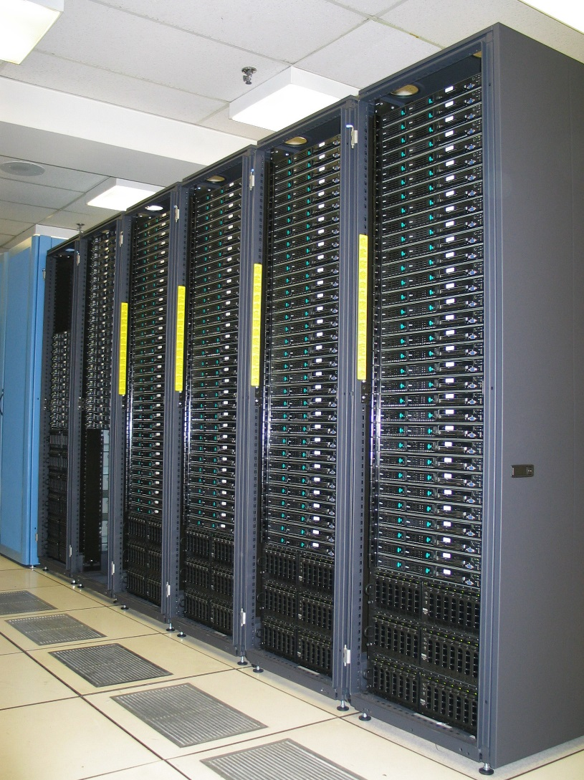
Clustering and Grid Computing
Clustering is useful when there is a need to process large volumes of data in parallel e.g.
  Weather forecasting,
  Web serving where 1000's of clients connect to a server every second
Clusters represent large numbers of closely linked computers such as the blades servers opposite.
“Beowulf” (for Linux) and Windows server provide services to seamlessly connect several networked computers and make them appear as one big server/cluster with the potential for massive parallel processing.
Grids are similar but more loosely connected, both physically and geographically.
http://en.wikipedia.org/wiki/Computer_cluster
http://en.wikipedia.org/wiki/Grid_computing
http://en.wikipedia.org/wiki/Blade_server
https://en.wikipedia.org/wiki/Beowulf_cluster
Racks containing “Blade servers”, complete slide-in computers with disk drives all running under 1 operating system

Slide 33
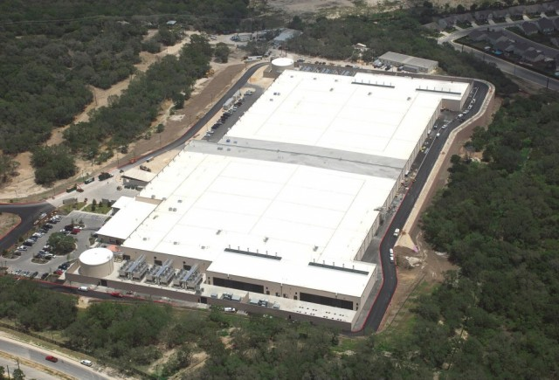
Clustering used in Data Centers
Clusters are often arranged into massive data centers, to handle 10’s of thousands of simultaneous user connections. The image below is Microsoft’s data center in San Antonio, Texas which typically houses > 100,000 blade servers.
Microsoft acknowledges that is has over 1 million servers around the world. (Less than Google, more than Amazon.).

